Slide 1



Nested DIO for Feature Selection
& Hyperparameter Optimization
Cross-Domain Validation: Medical Diagnostics → Computer Vision
Professor: Dr. Neggaz Nabil
Project on Github
Pesented by Bellatrache Mohamed Amine & Ghizlane Cherif Imane
USTO-MB | Computer Science | Data Science | Nov 2025

Slide 2
Outline
Introduction
1. Dholes-Inspired Optimization (DIO)
1.1 History & Origins
1.2 How DIO Works
1.3 Benchmark Comparisons
1.4 Applications
2. Optimization Across Domains
2.1 The Challenge We Faced
2.2 Optimization Methodology
2.3 Medical Domain: Breast Cancer
2.4 Computer Vision: CIFAR-10
2.5 Cross-Domain Insights
3. Future Research Directions and practical recommendations
4. DIO: Key Advantages and Limitations
5. Conclusion & Key Contributions
6. References
Parmigiano Caption

Slide 3
Introduction
Breast cancer is one of the deadliest diseases affecting women worldwide [2]
Machine learning shows promise, but faces real challenges:
- Medical datasets have 30+ features—which ones really matter?
- A model's success depends on both the features AND its settings
- Picking features first, then tuning later misses important connections
The old way: Choose features → Train model → Tune parameters
The problem: What if the best features change depending on the parameters?
•Our approach: Optimize both together using DIO [1]

Slide 4
1.1 DIO: History & Origins
•Created in 2025 by international researchers [1]:
Ali El Romeh
Seyedali Mirjalili
Václav Snášel
.
•Published in Cluster Computing (Springer)—a prestigious journal
• - DOI: 10.1007/s10586-025-05543-2
• - Peer-reviewed and rigorously tested
github

Slide 5
1.2 How DIO Works: The Hunting Strategies
Dholes use three hunting strategies:
Strategy 1: Chase the Leader
- Follow the best hunter toward the prey
- In optimization: Exploit the best solution found so far
Strategy 2: Try Random Directions
- Check what other pack members are discovering
- In optimization: Explore new areas of the search space
Strategy 3: Stick with the Pack
- Move toward the group's center
- In optimization: Balance between extremes, avoid getting stuck
DIO translates dhole pack hunting into mathematics

Slide 6
How DIO maps dhole behavior to algorithm:
Lead vocalizer → Best solution guides search
Vocal signals → V parameter controls exploration ↔ exploitation
Cooperative hunting → Pack moves cooperatively (avoid traps)
Territorial instincts → Boundary constraints (stay in valid zone)
Pack hierarchy → Dynamic leadership updates

Slide 7
DIO: The Math Behind It
A. Vocalization Influence (Eq. 1)
B. Movement Scaling Factor (Eq. 2)
V(t) = 2 - (2*t / MaxIter)
B = V × r
D. Distance to Lead Vocalizer (Eq. 4)
C. Sinusoidal Oscillation (Eq. 3)
D_lead = |C × (LeadVocalizer_pos)² - (dhole)²|
C = r + sin(r × π)
F. Boundary Constraints (Eq. 6)
E. Position Update (Eq. 5)
If D_i < lower_bound OR D_i > upper_bound: D_i = lower_bound + (upper_bound - lower_bound) × rand()
X_new = LeadVocalizer_pos +B × √(D_lead)
G. Lead Vocalizer Update (Eq. 7)
If fitness(D_i) > fitness(LeadVocalizer): LeadVocalizer = D_i

Slide 8
DIO Algorithm: Pseudocode
1. Initialize population D with random positions
2. Evaluate fitness of each dhole in D
3. Set lead_vocalizer = dhole with best fitness
4. For t = 1 to Max_iter do:
a. Calculate V using Eq. 1: V = 2 - (2 × t) / Max_iter
b. Determine phase (0 = exploration, 1 = exploitation)
c. For each dhole D_i in D do:
If phase == 0 (exploration):
If rand() < 0.5:
D_i = lb + rand(1, dim) × (ub - lb)
Else:
Calculate B (Eq. 2) and
Calculate D_lead (Eq. 4)
Update position using X_lead (Eq. 5)

Slide 9
iii. Apply boundary check for D_i (Eq. 6)
"Est-ce que ce dhole est sorti du territoire ?
iv. Evaluate fitness of D_i
v. If fitness(D_i) < fitness(lead_vocalizer):
lead_vocalizer = D_i
5. Return position of lead_vocalizer as best solution

Slide 10
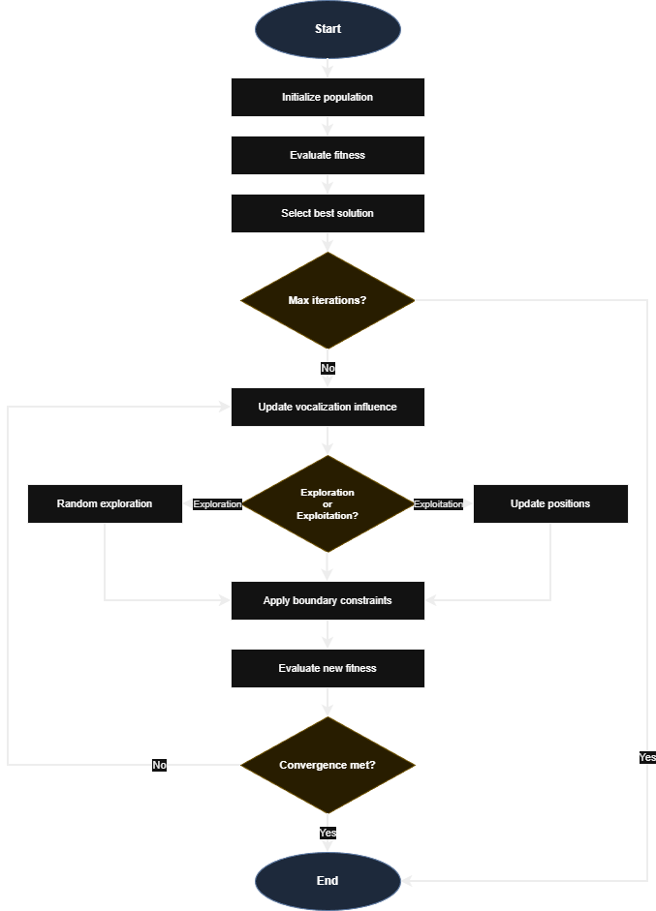
DIO Algorithm Flowchart [1]

Slide 11
Benchmark Comparaison with other metaheuristics [1]
•Tested on CEC2017—the gold standard for optimization algorithms
• - 29 different test functions (unimodal, multimodal, hybrid, composite)
• - Industry standard for comparing metaheuristics
•
•Compared against famous algorithms:
• - PSO (Particle Swarm Optimization)—inspired by bird flocking
• - GWO (Grey Wolf Optimizer)—inspired by wolf hunting
• - WOA (Whale Optimization Algorithm)—inspired by whale hunting
• - MFO (Moth-Flame Optimization)
• - ALO (Ant Lion Optimizer)
•
•Results speak for themselves:
• - DIO ranked 1st or 2nd on 22 out of 29 functions (22/29 )
• - Beats PSO and GWO consistently on complex problems
• - Particularly strong at avoiding local optima traps
•Bottom line: DIO is competitive with—and often better than—established algorithms

Slide 12
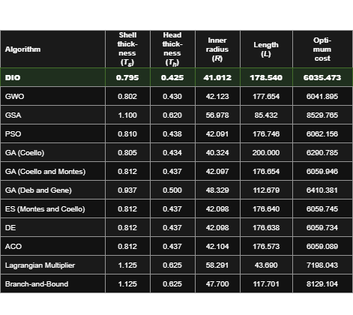
1.3 DIO vs. State-of-the-Art [1]

Slide 13
1.4 What Can You Use DIO For?
Engineering & Design
•- Structural optimization (designing bridges, aircraft parts)
• - Resource allocation in factories
Machine learning
• - Selecting which features to use from high-dimensional data
• - Tuning hyperparameters for better model performance
• - Neural architecture search for deep learning
Other interesting domains:
•- Financial portfolio optimization (maximizing returns, minimizing risk)
• - Energy grid management (balancing supply and demand)
• - Logistics and delivery route planning

Slide 14
Part 2: Optimization Across Domains
Now that we understand DIO, let's see how we applied it
• Two very different problems:
- Medical: Breast cancer diagnosis (30 features, binary classification)
- Vision: CIFAR-10 image classification (2048 features, 10 classes)
• What we'll cover:
- The challenge we didn't expect
- Our nested optimization methodology
- Results from medical domain (3 different approaches!)
- Extension to computer vision
- What we learned across both domains

Slide 15
2.1 The Challenge: Optimization Overfitting
We faced two distinct challenges during this research:
• Challenge 1: The Sequential Trap
- Traditional approach: Pick features first, tune parameters second
- Problem: Best features depend on which parameters you use!
- Solution: Optimize both simultaneously with nested DIO
• What happened? Optimization overfitting:
- The algorithm 'memorized' that specific data split
- Found parameters perfect for one partition, terrible for others
- Like studying only the practice exam and bombing the real one
• This discovery shaped everything that followed...
• Challenge 2: The Overfitting Surprise (discovered the hard way)
- Got 99% accuracy optimizing on one train-test split
- Tested across 30 different splits: only 94.37% average
- Even worse than not optimizing at all (94.89%)!

Slide 16
2.2 Our Nested Optimization Methodology
We developed a two-level optimization framework:
•Outer Loop: Hyperparameter Tuning (DIO controls this)
- Searches through model parameter space
- For Random Forest: number of trees, tree depth, split criteria
- For XGBoost: learning rate, max depth, regularization
•Fitness Function balances two goals:
- 99% weight: Maximize classification accuracy
- 1% weight: Minimize number of features used
Key advantage: Discovers how features and parameters interact—something sequential optimization misses
•Inner Loop: Feature Selection (nested DIO controls this)
- For each set of parameters, finds best feature subset
- Binary encoding: each feature is either used (1) or not (0)
- Example: [1,0,1,1,0...] means 'use features 1, 3, and 4'

Slide 17
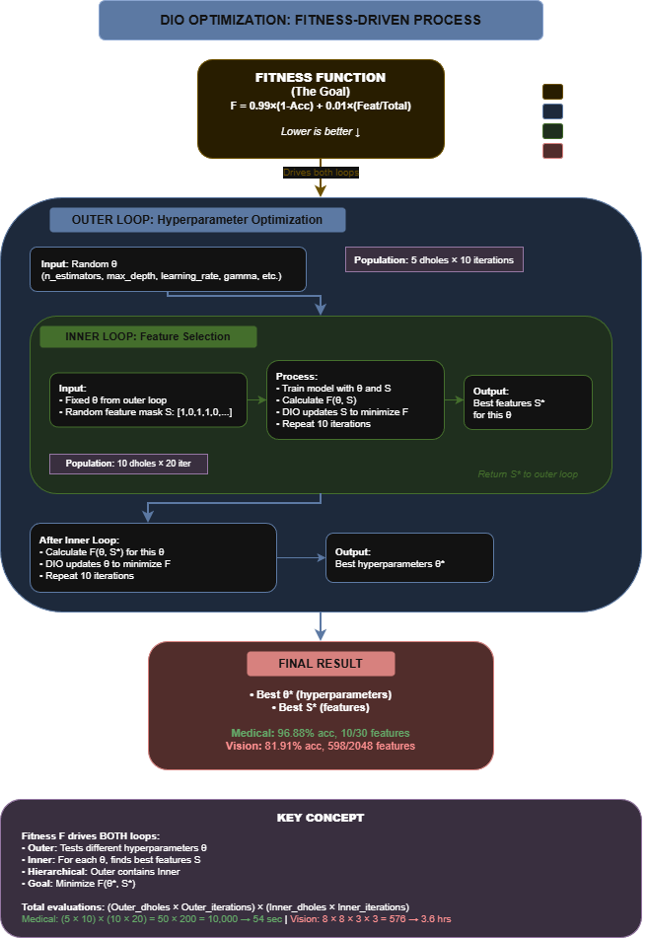
Two-level optimization: Outer loop (hyperparameters) + Inner loop (features)

Slide 18
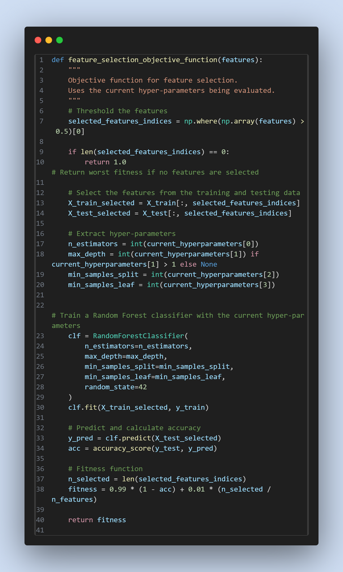
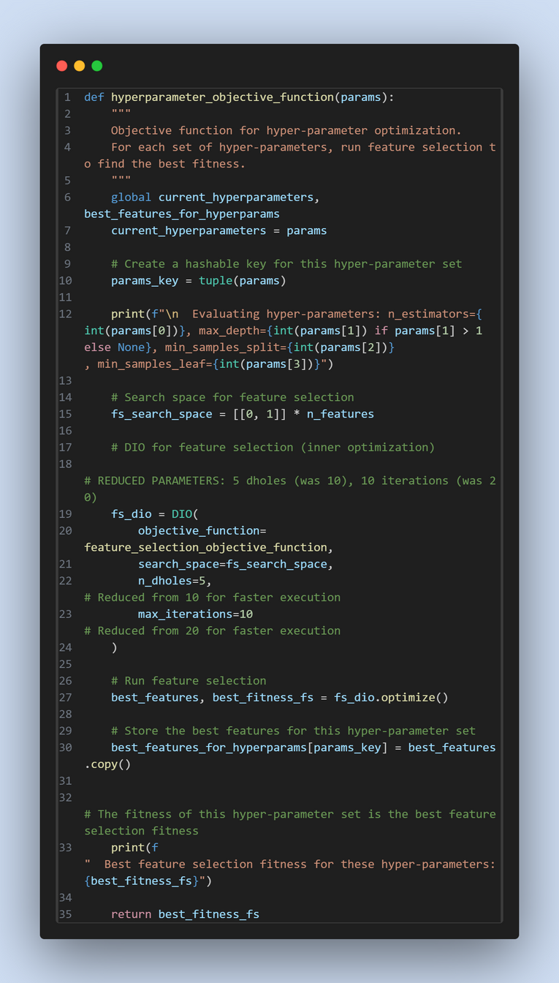
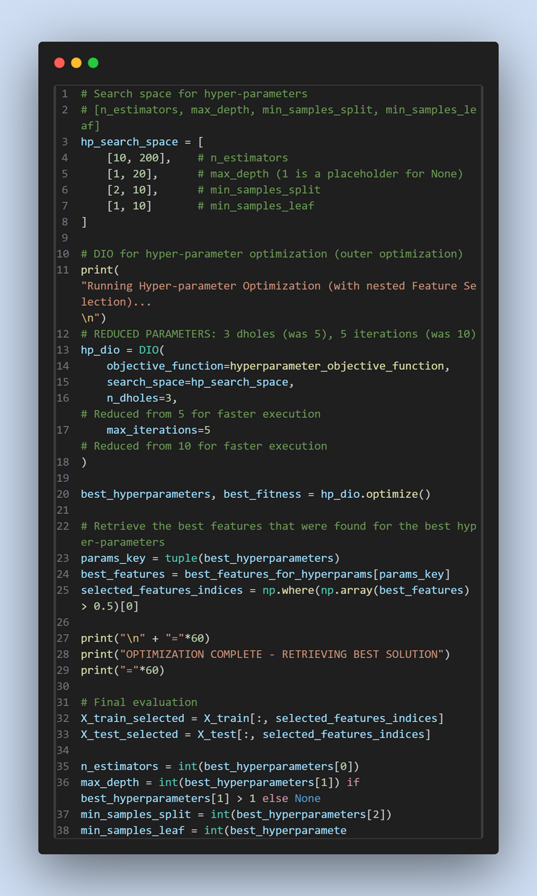
Feature Selection Objective Func RF
Hyperparameter Selection Objective Func RF
outer optimization and retreiving results

Slide 19
2.3 Medical Domain: Breast Cancer Dataset
•Wisconsin Diagnostic Breast Cancer Dataset [2]
- Source: UCI Machine Learning Repository (standard benchmark)
- 569 patients: 357 benign, 212 malignant tumors
•Why this matters clinically:
- Early, accurate diagnosis literally saves lives
- Fewer features → faster, cheaper screening tests
- Simpler models → doctors can actually understand them
Experimental setup: 70% training, 30% testing (stratified by class)
•30 features describing cell nuclei characteristics:
- Size measurements: radius, perimeter, area
- Texture: smoothness, compactness, concavity
- Shape: symmetry, fractal dimension
- Statistics: mean, standard error, worst (largest) values

Slide 20
2.3.1 Approach 1: DIO-RF Single Split (The Trap)
Our first attempt: Optimize on one fixed train-test split
Configuration: 5 dholes/10 iterations (outer), 10 dholes/20 iterations (inner)
Total evaluations: ~10,000 (50 outer × 200 inner)
But then we ran 30-run statistical validation [7]...
The harsh truth:
Average accuracy across 30 different splits: 94.44% ± 1.82%
Baseline (no optimization): 94.89% ± 1.47%
We actually made it WORSE by 0.17%!
What went wrong? Optimization overfitting:
DIO found parameters perfect for THAT ONE split
Didn't generalize to different data partitions
Classic case of 'overfitting' but at the optimization level, not model level
Initial results looked incredible:
Accuracy: 99.41% on that specific split
Only 8 features used (73% reduction from 30)
We thought we'd solved it!

Slide 21
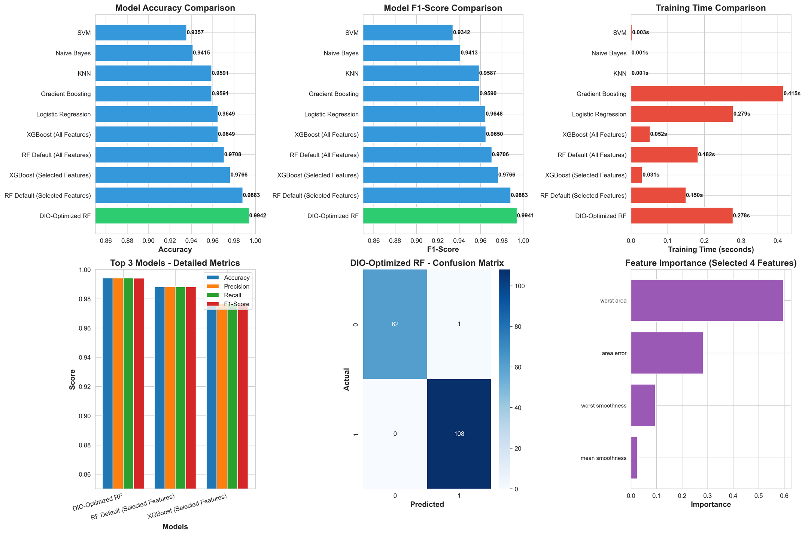
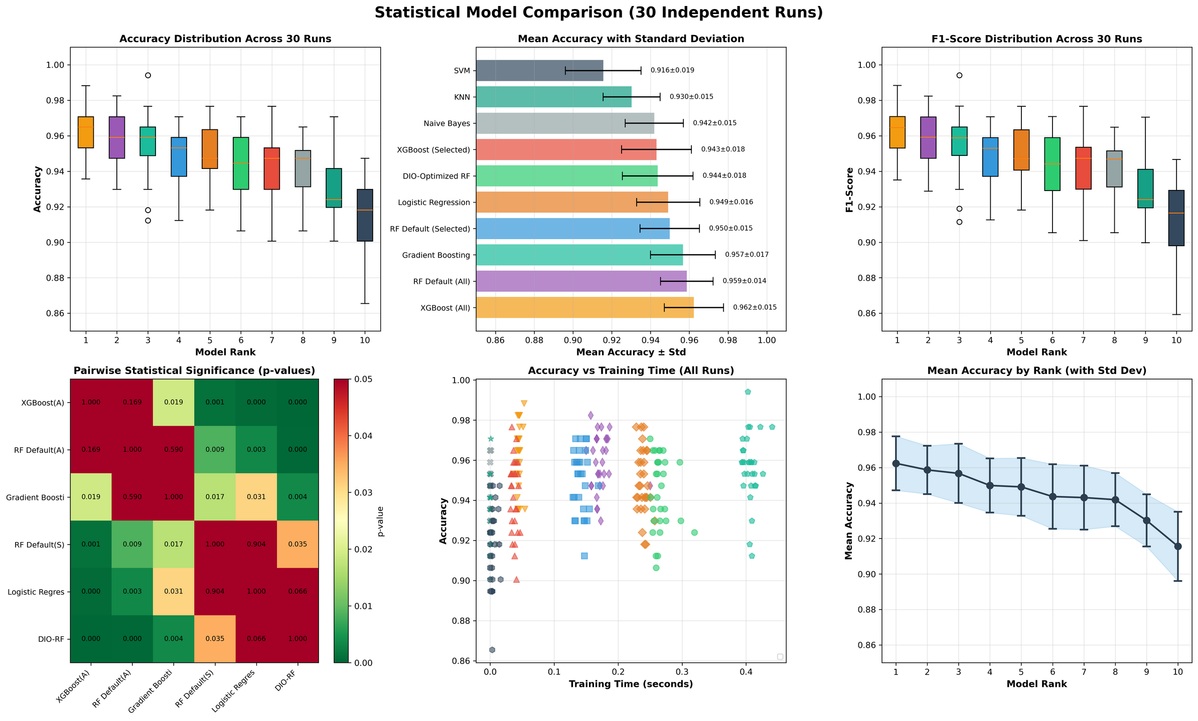
Single run model comparaison (RF)
(30 run) Statistical comparaison (RF)

Slide 22
2.3.2 Approach 2: DIO-RF with Cross-Validation (The Fix)
•The solution: Change how we evaluate during optimization
Instead of one train-test split:
Use 5-fold cross-validation DURING the DIO search
Each candidate solution tested on 5 different data partitions
Fitness score = average performance across all 5 folds
Makes it impossible to 'cheat' by memorizing one partition
Comparison to broken single-split approach:
+1.54% accuracy improvement (statistically significant p < 0.001)
More stable (lower standard deviation)
Overall rank: #1 among all deafult modesls tested
The lesson: Use cross-validation during optimization, not just for final evaluation
Results after fixing (30-run validation):
Average accuracy: 96.65% ± 1.51%
Features used: Only 6 out of 30 (80% reduction!)
F1-score: 0.9632

Slide 23
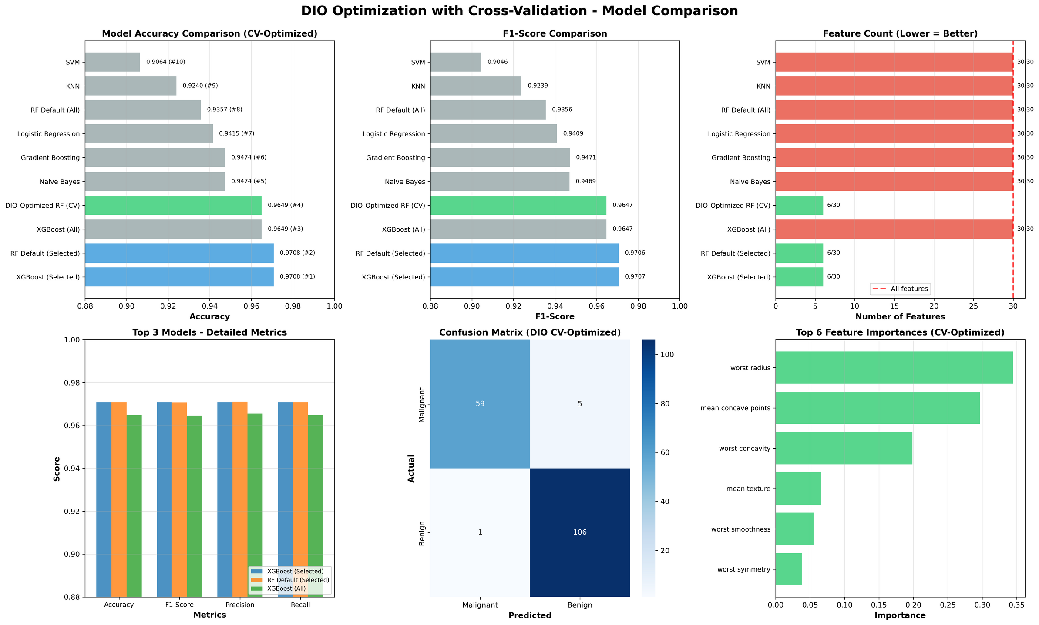
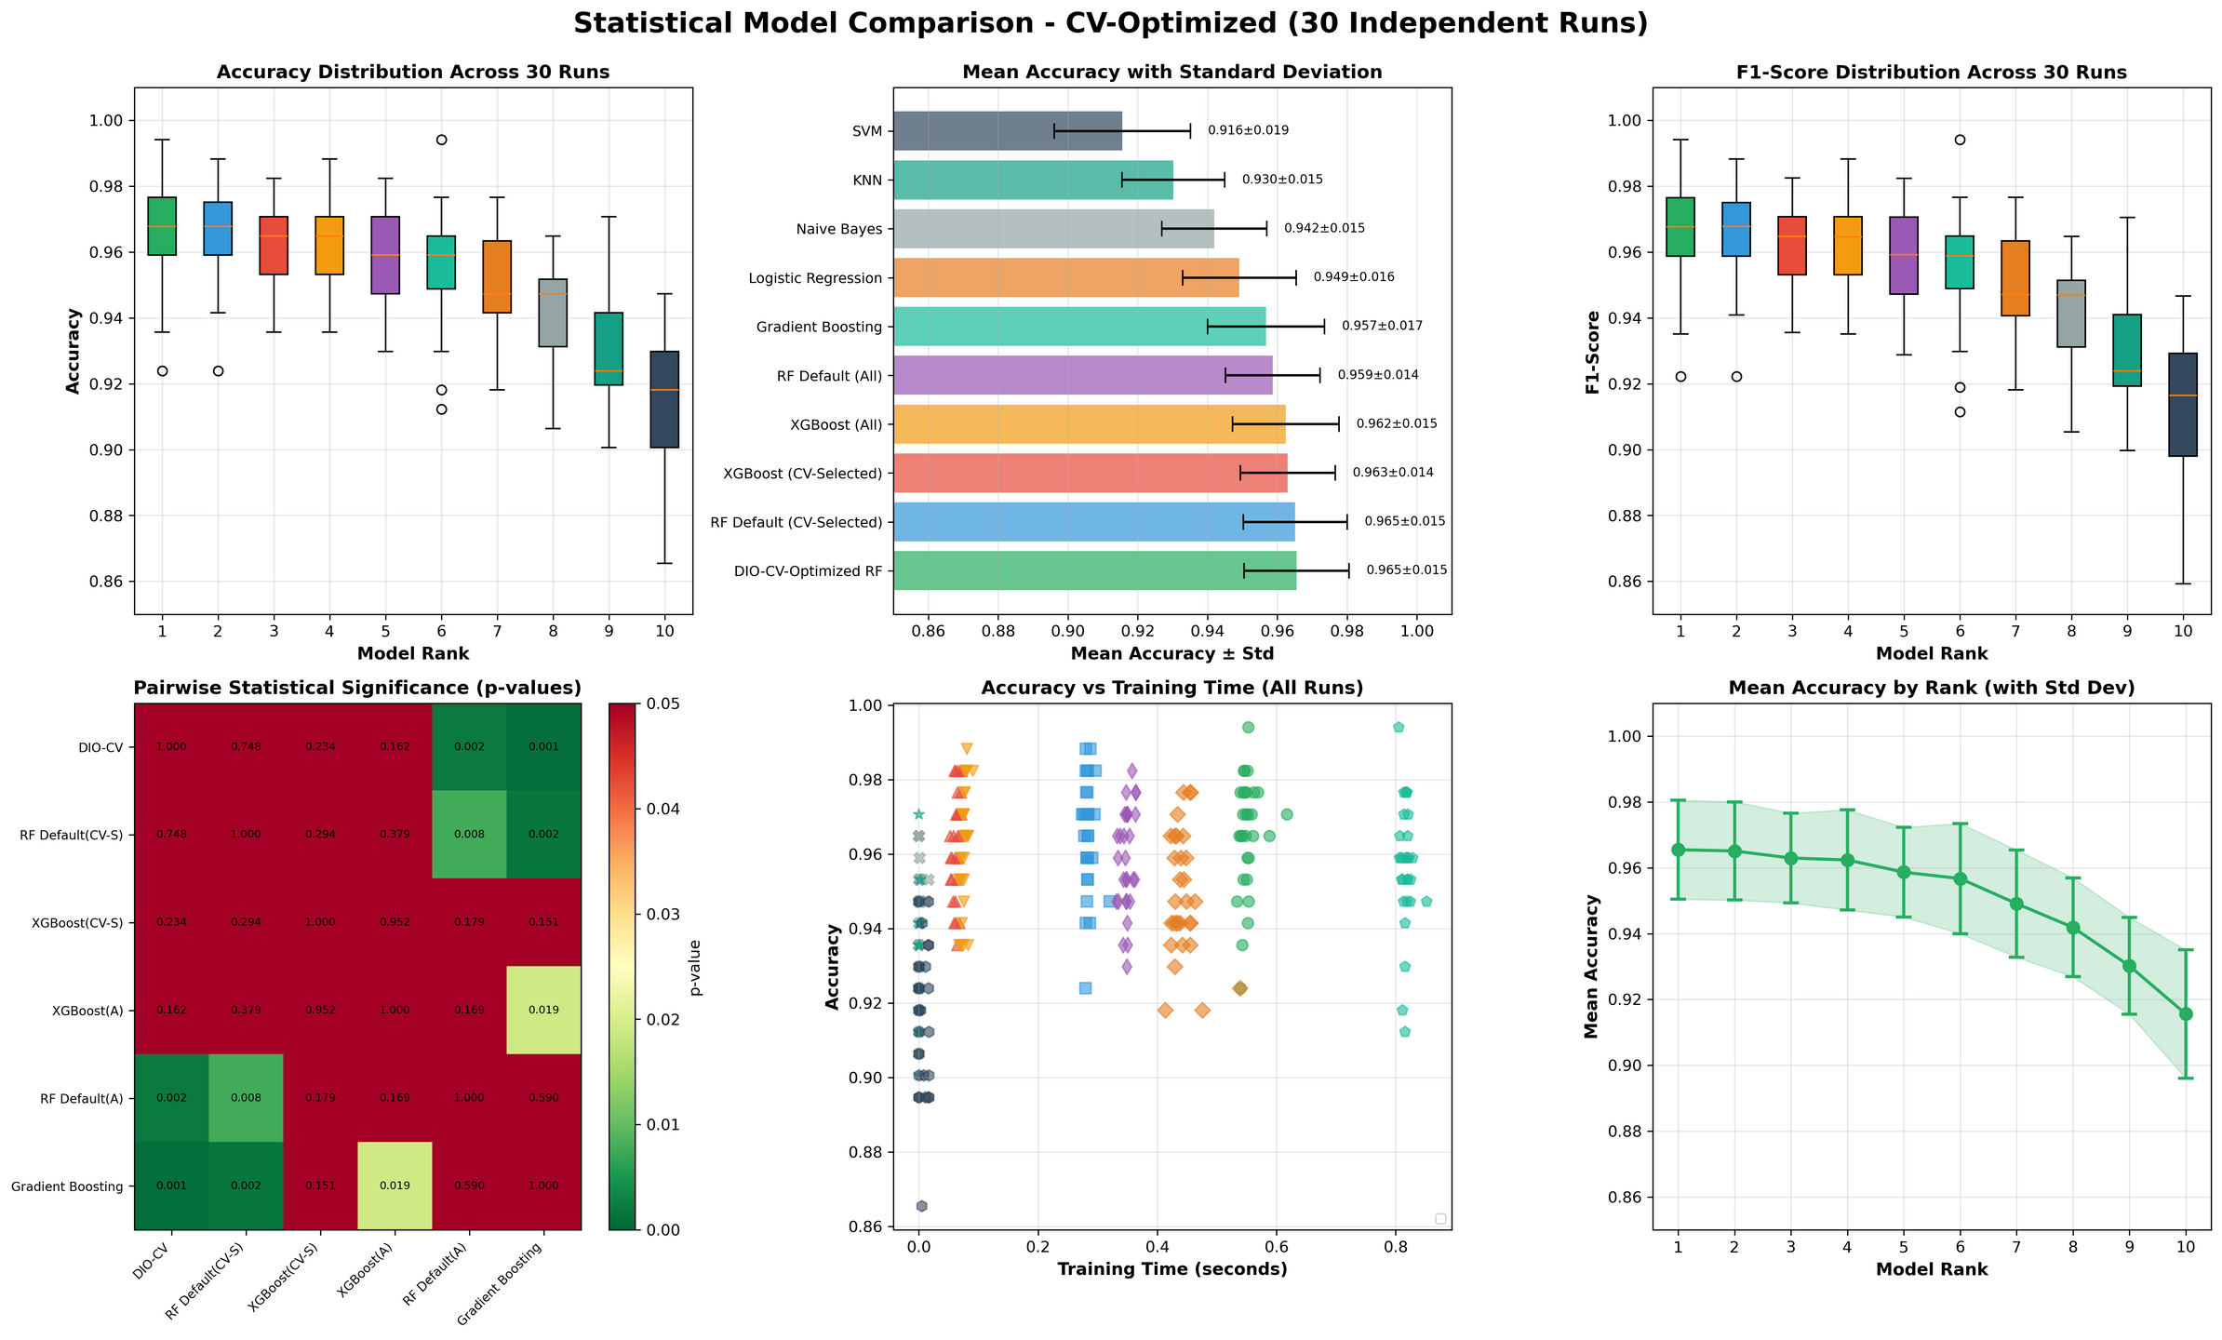
Single run model comparaison (RF-CV)
(30 run) Statistical comparaison (RF-CV)

Slide 24
2.3.3 Approach 3: DIO-XGBoost (The Champion)
Wait—can we do even better with a different algorithm?
Configuration: 5 dholes/10 iterations (outer), 10 dholes/20 iterations (inner)
Total evaluations: ~10,000 (50 outer × 200 inner)
Only 54 seconds optimization time!
DIO-XGBoost results (30-run validation):
Average accuracy: 96.88% ± 1.10%← HIGHEST OF ALL APPROACHES
Features: 10 out of 30 (67% reduction)
Overall rank: #1 (best performing method)
Why try XGBoost [5]?
Gradient boosting with built-in regularization
More hyperparameters to tune (learning rate, tree depth, subsample ratio)
Widely known to be more robust than Random Forest
Gold standard for tabular data competitions (Kaggle, etc.)
Statistical significance:
Significantly better than XGBoost defaults (p = 0.0411) with all features
Outperformed both Random Forest approaches
Lowest variance (most stable predictions)

Slide 25
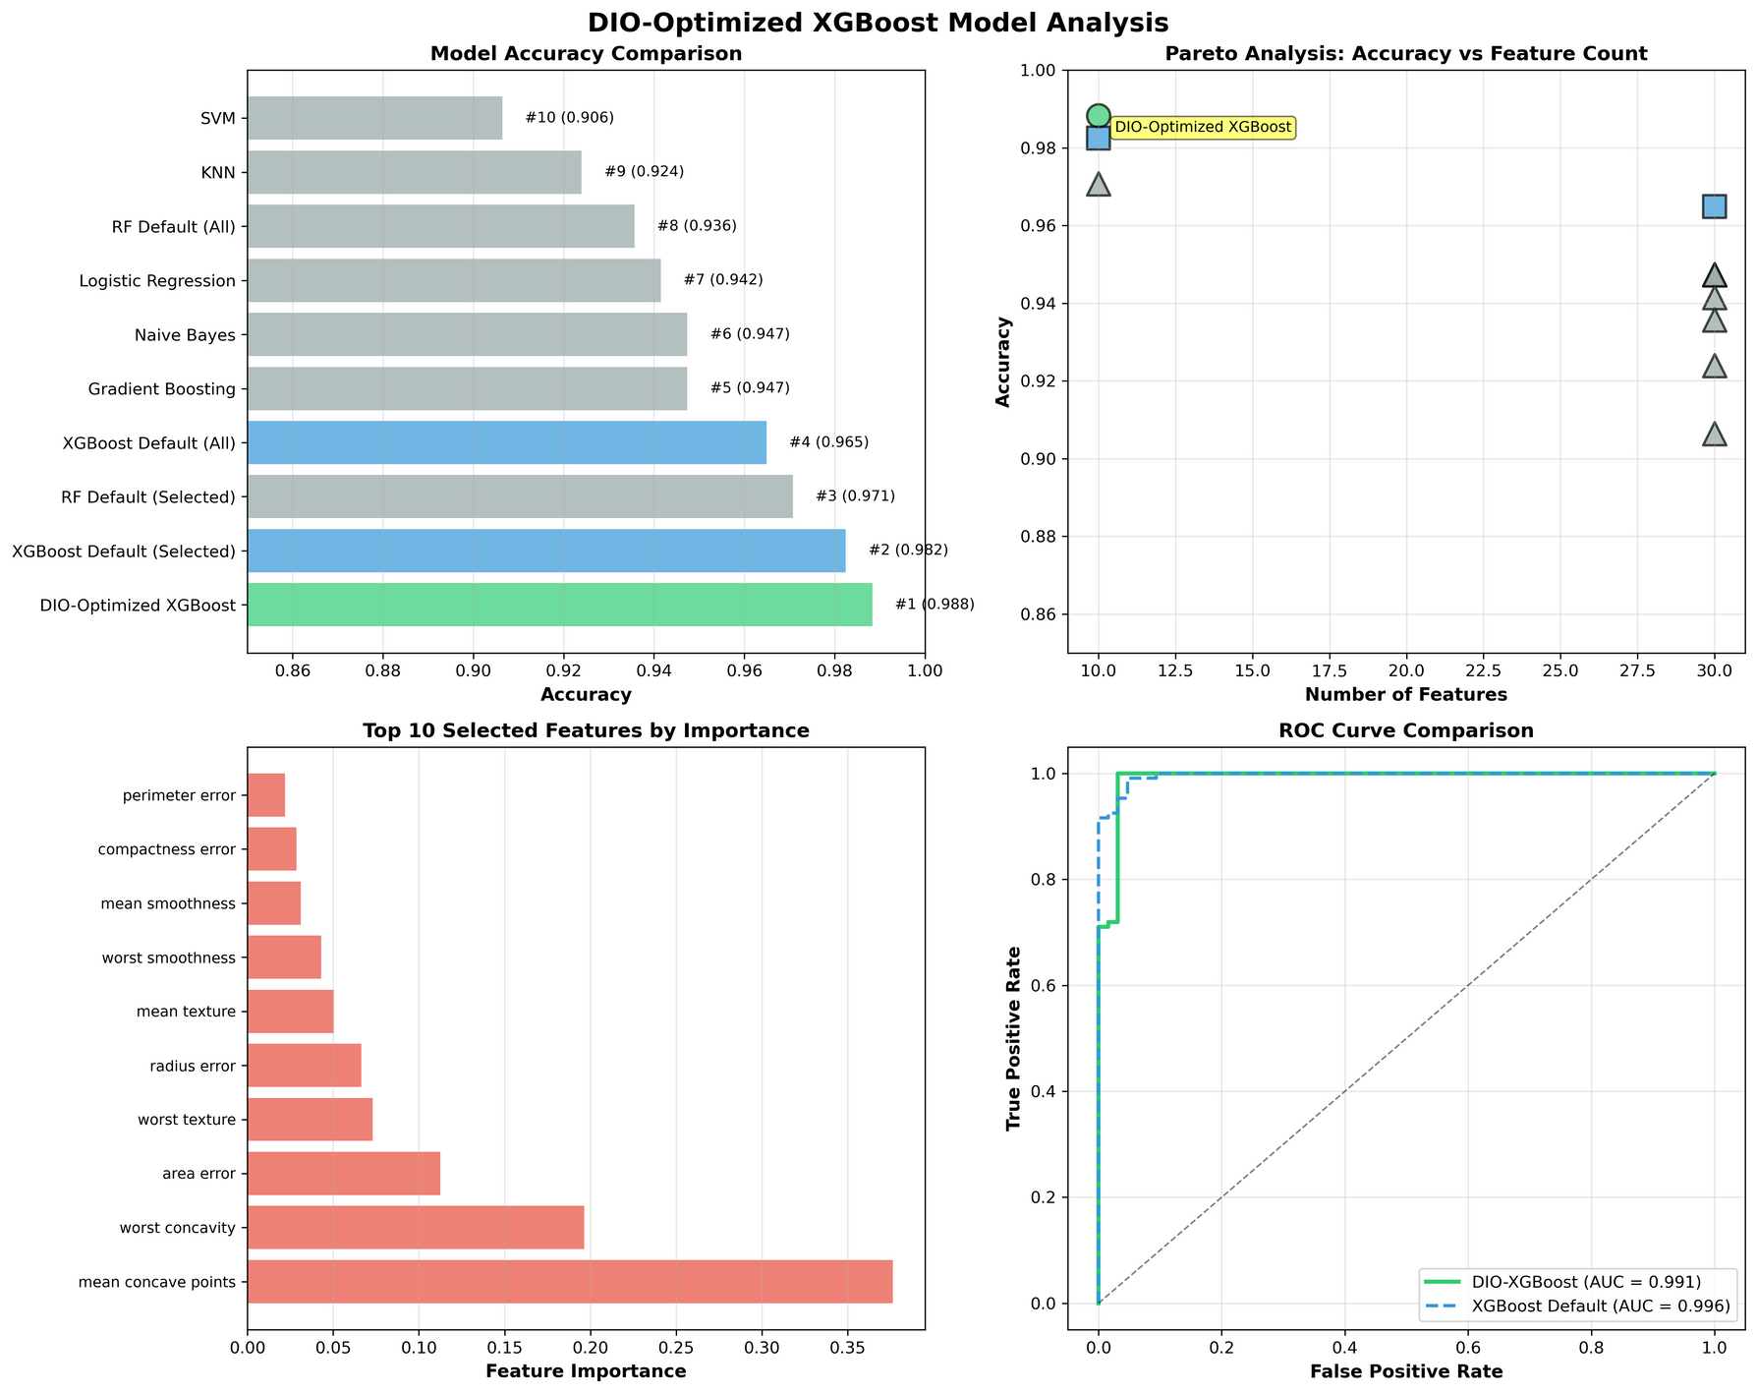
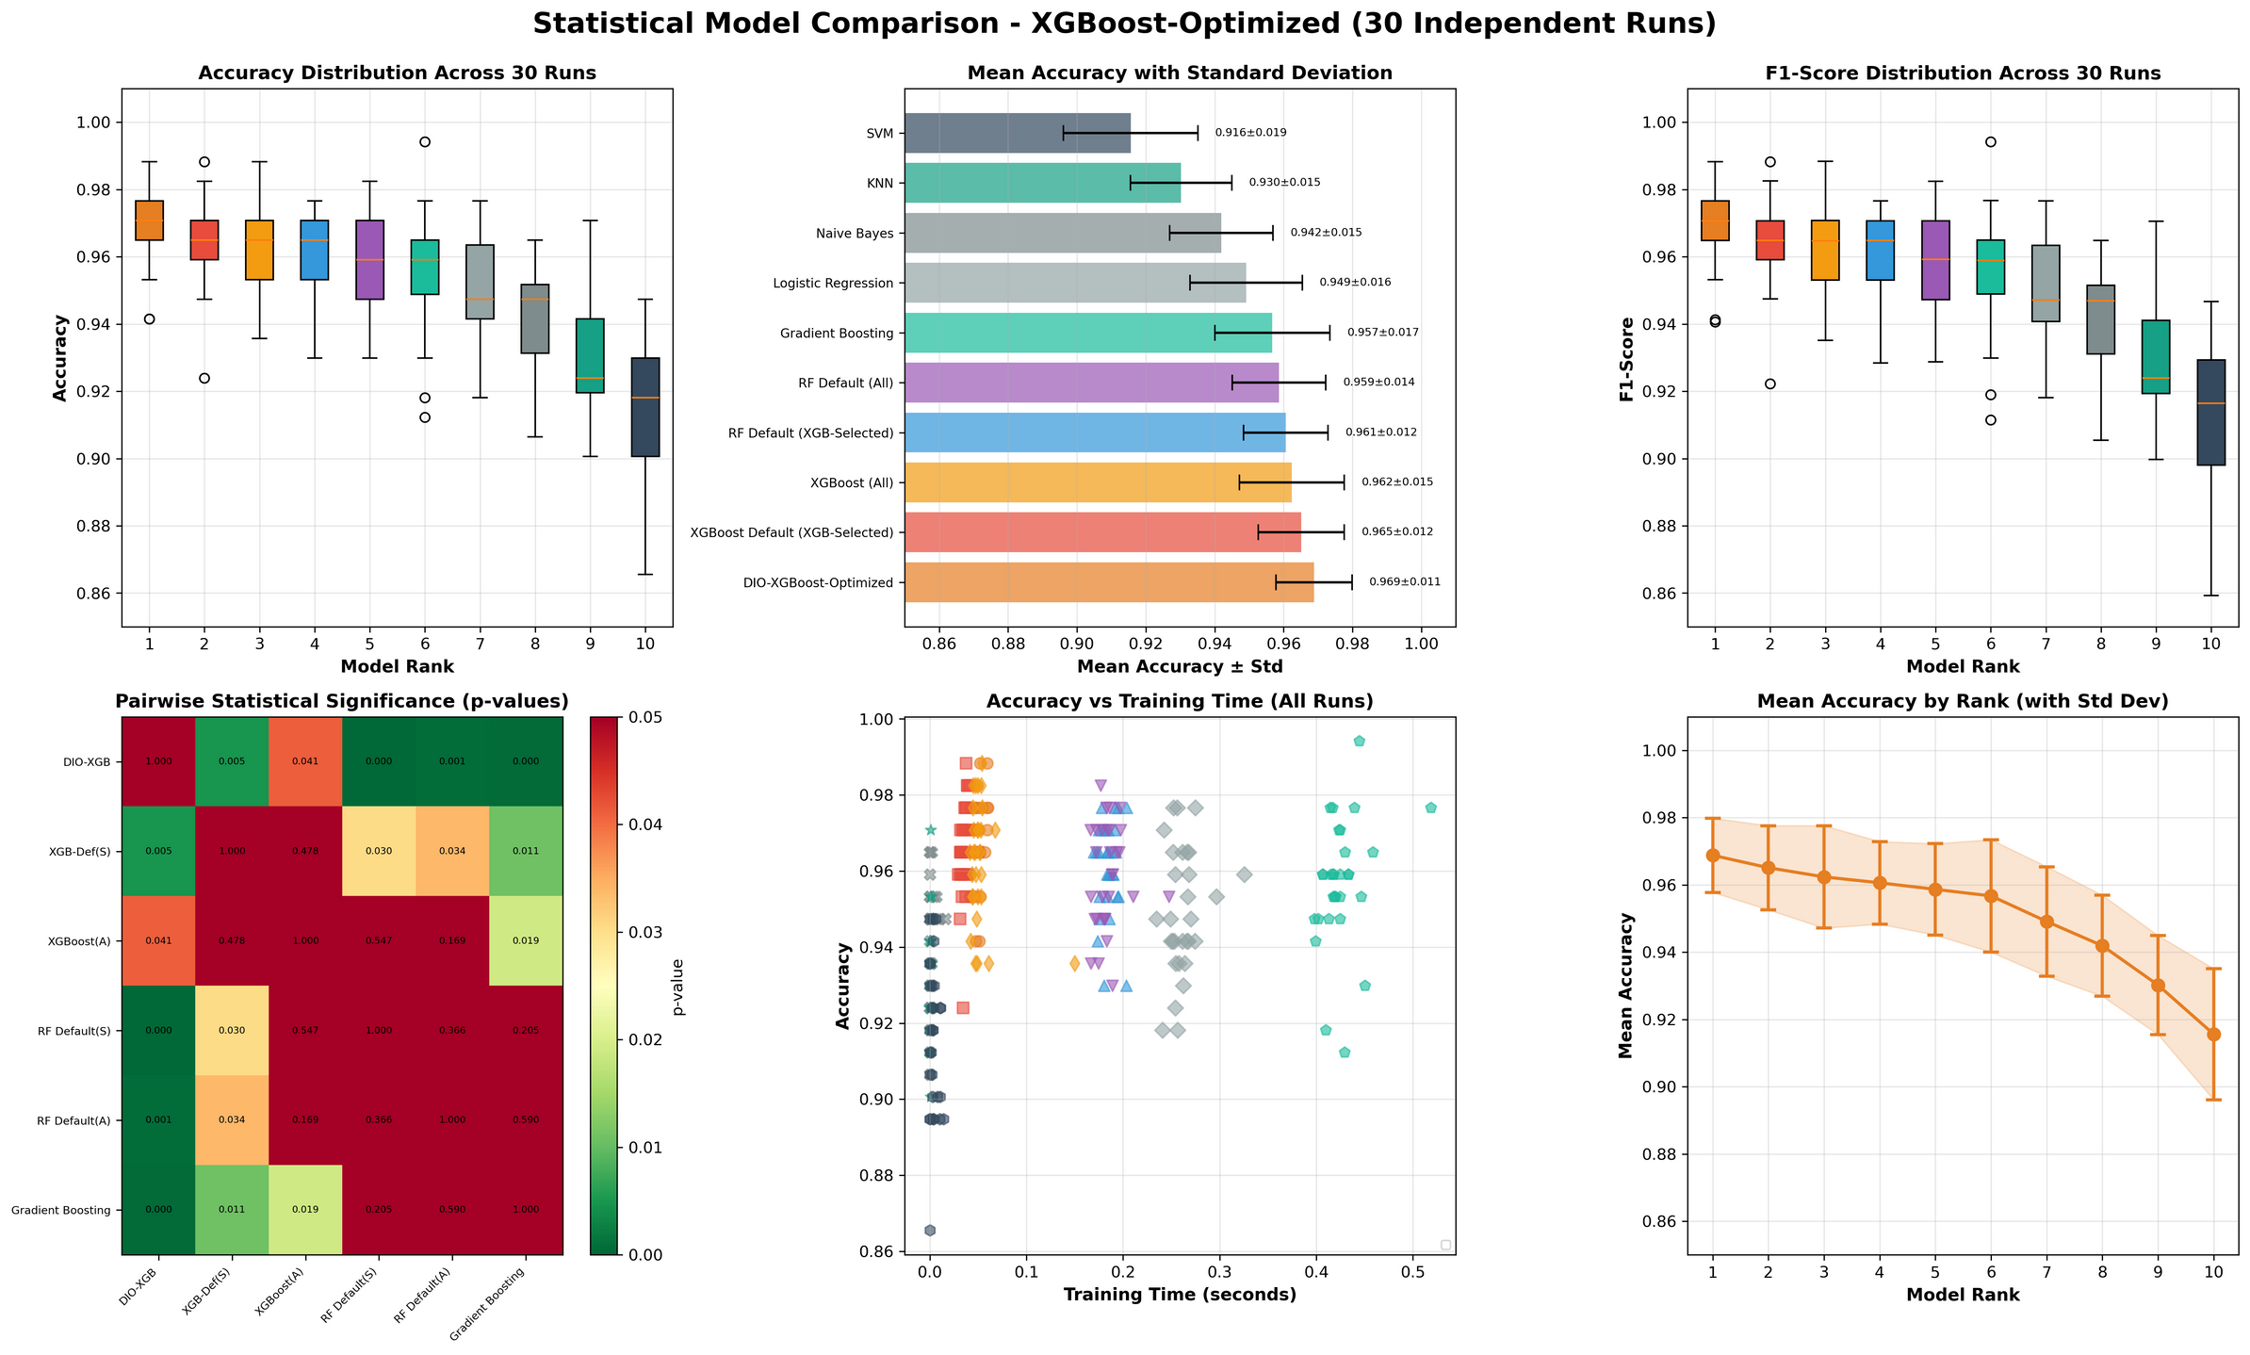
Surprising finding:
XGBoost didn't need cross-validation during optimization!
Single-split worked fine (inherent regularization prevented overfitting)
Algorithm choice matters for optimization strategy
Single run model comparaison (XGBoost)
(30 run) Statistical comparaison (XGBoost)

Slide 26
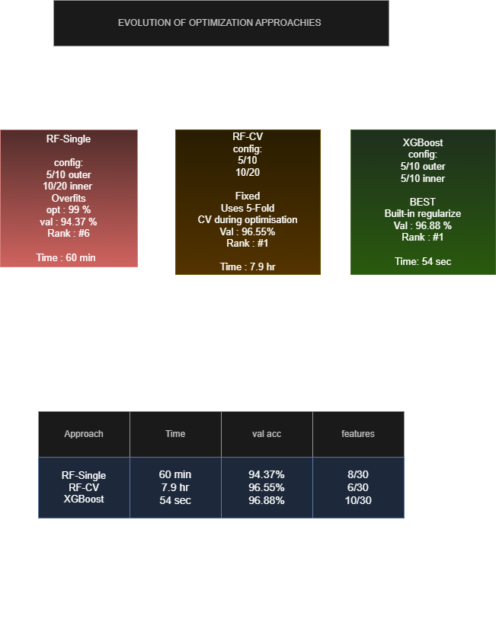
2.3.4 Medical Results: Three Approaches Compared
Evolution from RF Single-Split (failed) → RF-CV (fixed) → XGBoost (best)

Slide 27
2.3.5 Statistical Rigor: Wilcoxon Signed-Rank Test [7]
30 runs give us averages—but are differences real or just luck?
Wilcoxon Signed-Rank Test:
Non-parametric test (doesn't assume normal distributions)
Compares paired samples (same data splits for fairness)
Null hypothesis: 'No real difference between methods'
Results for DIO-RF-CV vs DIO-RF-Single:
p < 0.001 (***) → Cross-validation dramatically better
Confirms CV is essential for RF optimization
Significance levels:
* p < 0.05 (significant)
** p < 0.01 (very significant)
*** p < 0.001 (extremely significant)
ns = not significant (could be chance)
Results for DIO-XGBoost vs baselines:
vs XGBoost Default: p = 0.0411 (*) → Significant improvement
Mean difference: +1.60% accuracy
vs RF Default: p < 0.001 (***) → Highly significant improvement

Slide 28
2.4 Computer Vision Domain: CIFAR-10
Can DIO work beyond medical data? Let's test on images
CIFAR-10 Dataset [3]:
60,000 natural images (32×32 pixels, color)
10 classes: airplane, car, bird, cat, deer, dog, frog, horse, ship, truck
Standard benchmark in computer vision research
The massive challenge:
Medical: 30 features (search space size)
Vision: 2048 features (68× larger!)
Much harder to optimize—needs way more computation
Our approach:
Used ResNet50 [4] (pretrained on ImageNet) to extract features
Converted images → 2048-dimensional feature vectors
Computational subset: 2,500 images (2000 train, 500 test)
Applied DIO-XGBoost optimization

Slide 29
2.4.1 CIFAR-10 Results: When Budget Isn't Enough
The disappointing truth:
DIO-XGBoost: 81.91% ± 1.38% (Rank #3)
XGBoost Default: 83.27% ± 1.25% (Rank #1) ← Actually BETTER
Wilcoxon test: p = 7.15×10⁻⁵ (***) → Highly significant WORSE
We ran the same DIO-XGBoost optimization on CIFAR-10
Configuration: 3 dholes/8 iterations for BOTH loops (reduced for speed)
Total evaluations: ~576 (24 outer × 24 inner)
Optimization time: 3.6 hours
What went wrong? Insufficient optimization budget:
Medical: 30-D space, 10,000 evaluations → SUCCESS (5/10 + 10/20)
Vision: 2048-D space, 576 evaluations → FAILURE (3/8 + 3/8)
Budget didn't scale with dimensionality (68× larger space!)
Need ~10,000-50,000 evaluations for 2048-D (17-87× more)
Single-run result looked okay:
DIO-optimized (598 features): 83.0% accuracy
Baseline (all 2048 features): 80.8% accuracy
Seemed like +2.2% improvement with 70.8% feature reduction
But then came the 30-run statistical validation...
Optimization overfitting strikes again—even XGBoost can't overcome severe under-budgeting

Slide 30
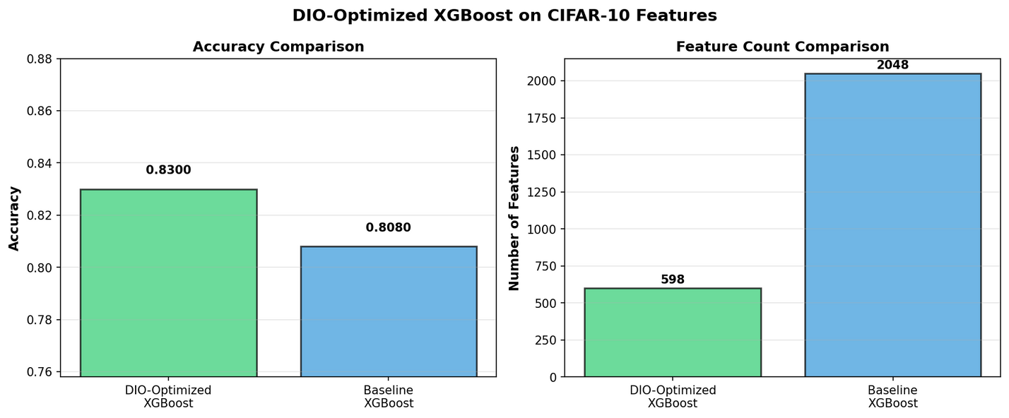
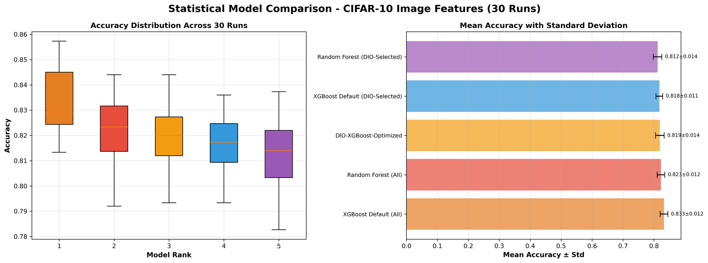
Single run model comparaison
(30 run) Statistical comparaison

Slide 31
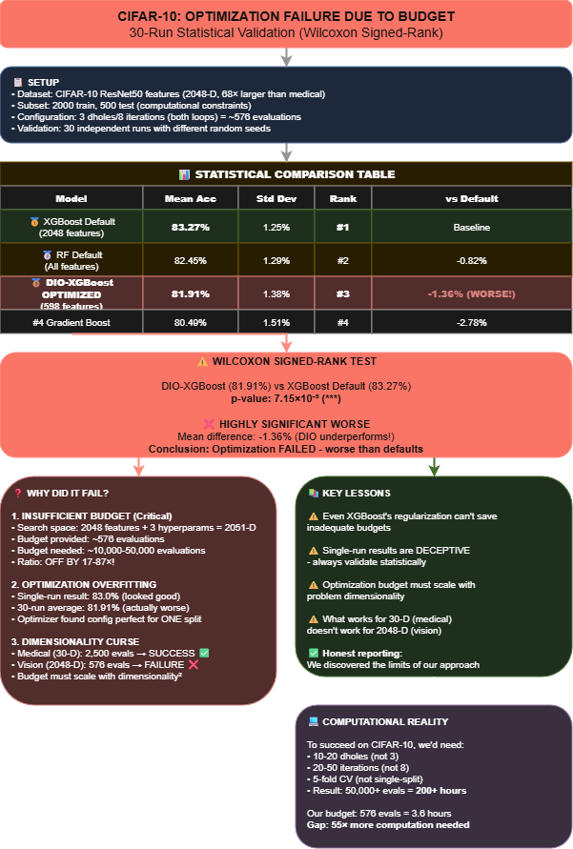
CIFAR-10: Statistical Analysis of Optimizataion Failure
30-run validation reveals DIO underperforms defaults: 81.91% vs 83.27% (p<0.0001)

Slide 32
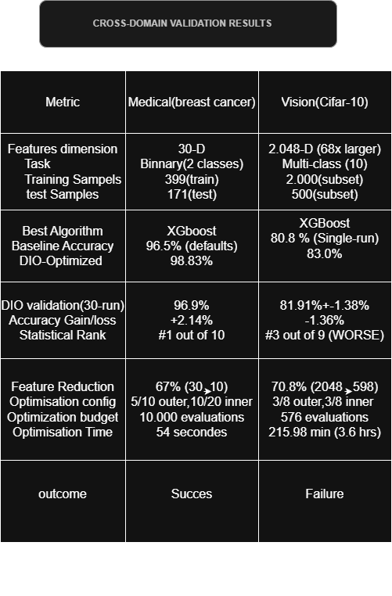
2.5 Cross-Domain Results: Success vs Failure
Complete comparison: Medical (96.9%, SUCCESS) vs CIFAR-10 (81.91%, FAILURE)

Slide 33
1. Adaptive Budget Allocation
Automatically adjust population size based on dimensionality
Develop formulas: budget ≈ k × D² (where D = dimensions)
Balance computational cost with quality
3. Future Research Directions
2. Hybrid Optimization Strategies
Combine DIO (global search) with local refinement (Bayesian optimization)
Use DIO for exploration, gradient methods for exploitation
3. Broader Applications
Other medical tasks: multi-class diagnosis, survival prediction
Neural architecture search with DIO
Fairness-aware feature selection (removing biased features

Slide 34
For Healthcare ML Deployment:
🏆 DIO-XGBoost: 96.88%, 10 features
→ Best accuracy, use when resources available
✓ DIO-RF-CV: 96.55%, 6 features
→ Best interpretability, 80% cost reduction
Practical Recommendations
⚠ DIO-RF-Single: 94.37%, 8 features
→ Only for rapid prototyping
Golden Rules:
Always validate with 30+ runs
Use statistical tests (Wilcoxon)
Scale budget with dimensionality

Slide 35

DIO: Key Advantages
Superior convergence speed
Excellent exploration-exploitation balance
Outstanding local minima avoidance
Low variance, high stability
Real-world engineering success
Easy implementation

Slide 36
DIO: Key Limitations
Parameter sensitivity (population size, iterations)
High computational cost for large-scale problems
No global optimality guarantee
Variable performance across problem types

Slide 37
5. Conclusion: Key Contributions
1. Discovered 'Optimization Overfitting'
→ Use CV during optimization, not just evaluation
2. Algorithm-Dependent Strategies
→ RF needs CV; XGBoost more robust but not immune
3. Budget Scaling Laws
→ Budget must scale with dimensionality²
4. DIO-XGBoost Success: 96.88% accuracy, 67% fewer features
Bottom line: Optimization needs adequate computational investment

Slide 38
Refrences
[1] El Romeh, A., Mirjalili, S., & Šnel, V. (2025). Dholes-Inspired Optimization (DIO). Cluster Computing (Springer). DOI: 10.1007/s10586-025-05543-2
[2] Dua, D. & Graff, C. (2019). UCI Machine Learning Repository: Breast Cancer Wisconsin (Diagnostic) Data Set. University of California, Irvine.
[3] Krizhevsky, A. (2009). Learning Multiple Layers of Features from Tiny Images. Technical Report, University of Toronto.
[4] He, K., Zhang, X., Ren, S., & Sun, J. (2016). Deep Residual Learning for Image Recognition. IEEE CVPR.
[5] Chen, T. & Guestrin, C. (2016). XGBoost: A Scalable Tree Boosting System. KDD '16.
[6] Breiman, L. (2001). Random Forests. Machine Learning, 45(1), 5-32.
[7] Wilcoxon, F. (1945). Individual Comparisons by Ranking Methods. Biometrics Bulletin, 1(6), 80-83.

Slide 39
Thank you for your time

